Slide 1

Signed Networks in Social Media
Jure Leskovec
Daniel Huttenlocher
Jon Kleinberg

Slide 2
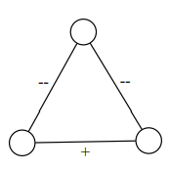
연구 개요
Relations between users on social media sites often reflect a mixture of positive (friendly) and negative (antagonistic) interactions.
Researches has focused almost exclusively on positive interpretations of links between people
Source : on-line social networks
‘Signed Network’

Slide 3
연구 개요
classical theory : ‘Structural Balance’
capture certain common patterns of interaction
at odds with some of the fundamental phenomena we observe (evolving, directed)
Alternate theory
-> one of the first large-scale evaluations of theories of signed networks using on-line datasets
-> perspective for reasoning about social media sites

Slide 4
연구의 필요성
Structure of networks in social computing applications
offers insights into patterns of interactions
reveals global phenomena at scales that may be hard to identify when looking at a finer-grained resolution
Richness(complex) -> Stylized network representation(simple) stylized

Slide 5
접근 방법
theories from social psychology (social balance, social status .etc)
-> analyzing signed networks of social computing applications
-> characterize the differences between the observed and predicted configurations

Slide 6
연구에 필요한 요소
large-scale datasets from social applications where the sign of each link can be reliably determined
theories of signed networks (Balance, Status)

Slide 7
Datasets
Explicit
Epinions (product review) : trust or distrust
Slashdot (blog) : “friends” or “foes
Implicit
Wikipedia admin candidates : public votes in favor of or against
Edges in networks derived from the datasets are directed

Slide 8
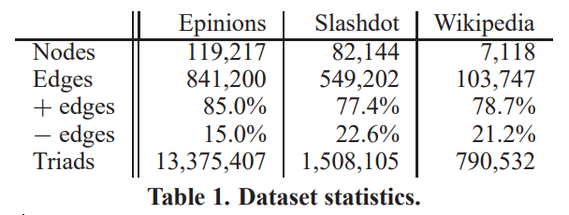
Datasets
Background proportion

Slide 9
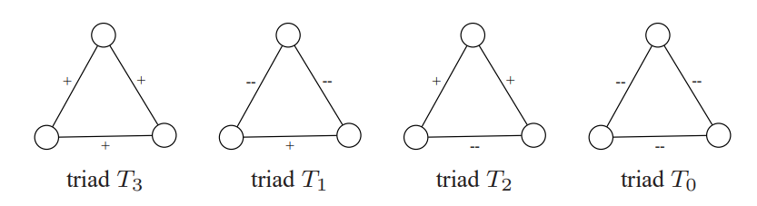
Theories of signed networks: Balance
Initially made for undirected networks
triangles on three individuals can be signed
balanced (T3, T1), unbalanced (T2, T0)

Slide 10
Theories of signed networks: Balance
Weak Structural Balance
eliminating - the enemy of my enemy is my friend
only triangles with exactly two positive edges are implausible in real networks
balanced (T3, T1, T0), unbalanced (T2)

Slide 11
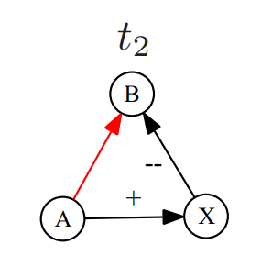
Theories of signed networks: Status
Directed networks of signed links
a positive(negative) directed link : the recipient as having higher(lower) status

Slide 12
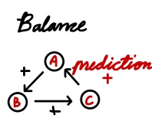
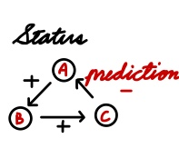
Comparing the two theories
a user A links positively to a user B, and B in turn links positively to a user C

Slide 13
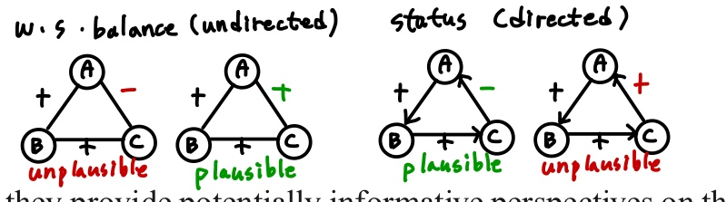
Theories of signed networks: Balance
(Weak Structural Balance)
two positive edges are massively underrepresented
triangles with three positive edges are massively overrepresented
difficult to evaluate the predictions on large network datasets

Slide 14
추가적인 요소
several experimental conditions
including both directed and undirected networks
Respecting and ignoring the order in which edges were created
Heterogeneity
Generative / Receptive

Slide 15
연구의 결론
Comparison of balance and status provides insights into ways in which people use linking mechanisms in social computing applications
: to be used more dominantly for expressions of status (Epinions, Wiki)
Contrast between balance and status - distinction between undirected and directed interpretations of links
: different theories to be appropriate to different levels of resolution in the representation of a single network

Slide 16
연구의 결론 (insight)
balance hold more strongly on the subset of links in these networks that are reciprocated (small proportion)
: reciprocal link follow different pattern of use
connection between the sign of a link and the extent to which it is embedded
: many common neighbors (on display) -> more likely to be positive

Slide 17
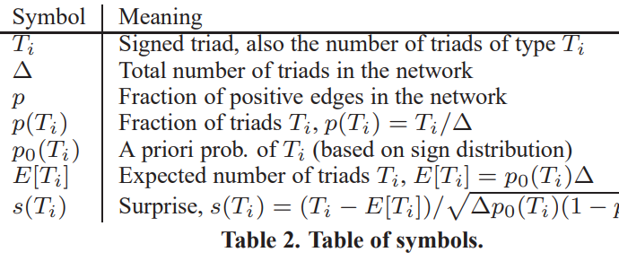

Slide 18
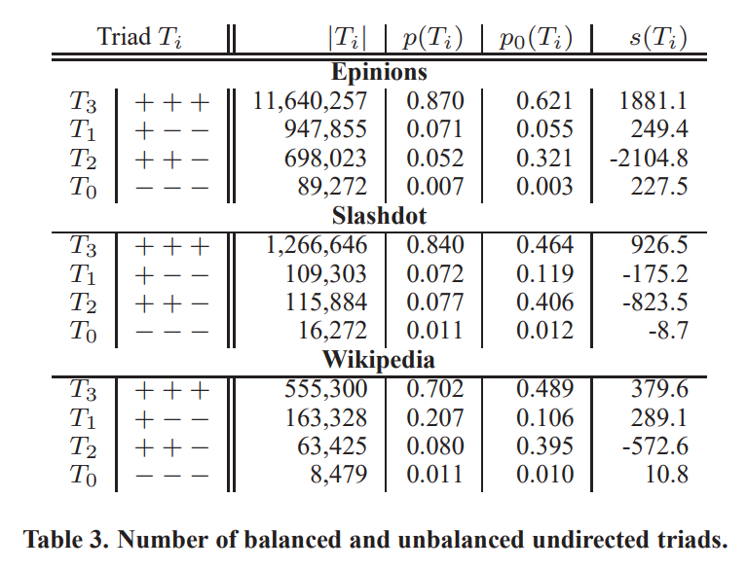
ANALYSIS OF UNDIRECTED NETWORKS
p0 : shuffle signs of all edges
p(Ti) > p0(Ti) : over-rep
-> T3
p(Ti) < p0(Ti) : under-rep
-> T2

Slide 19
ANALYSIS OF EVOLVING DIRECTED NETWORKS
1. links are created at specific points in time – order in which links are added
A -> X -> B (semi-path) // A – B (shortcut)
2. different users make use of positive and negative signs differently
(mix, almost exclusively one sign)
-> generative baseline / receptive baseline

Slide 20
Motivating Example (context)
축구 팀에 선수 A와 B 그리고 어떤 동료 X가 있다
인터뷰를 통해 X에게 A와 B가 자신(X) 보다 잘하는지 묻는다 (status)
Directed Graph
이때, X가 A도, B도 모두 자신보다 잘한다고 말했다면? (못한다고 했을 때도 동일)
B는 X보다 잘하므로, 평균보다 높은 status 를 가질 확률이 크다. 따라서, A는 무작위로 한 동료에게 link를 생성할 때보다 B에게 positive 한 link를 생성할 가능성이 높다.
A의 경우에서 봐도 마찬가지

Slide 21
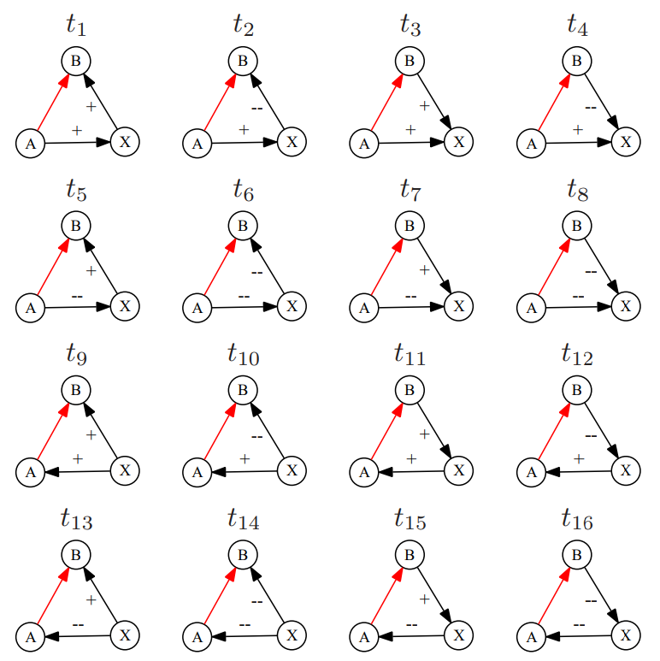
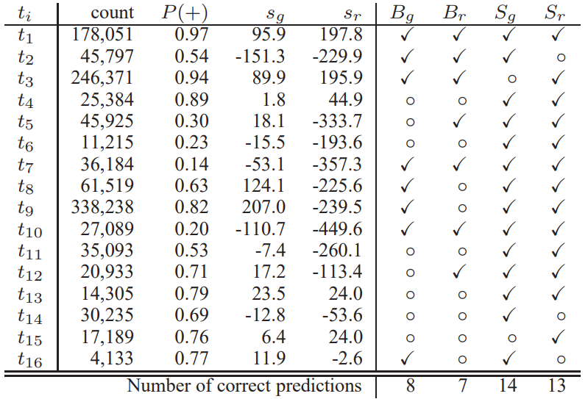
Contextualized Links (c-links)
P(+): prob. That closing red edge is positive;
sg: surprise of edge initiator giving a positive edge;
sr: surprise of edge destination receiving a positive edge;
Bg: consistency of balance with generative surprise;
Br: consistency of balance with receptive surprise;
Sg: consistency of status with generative surprise;
Sr: consistency of status with receptive surprise.

Slide 22
Result
the predictions of status with respect to both generative and receptive surprise perform much better than the predictions of structural balance
status is consistent with generative (14) and receptive (13) surprise on the vast majority of c-link types
Failed on t3 -> structural balance (f-f-f)
constitute natural “duals” to each other (reverse the direction and the sign)
(t3 and t14, t2 and t15)

Slide 23
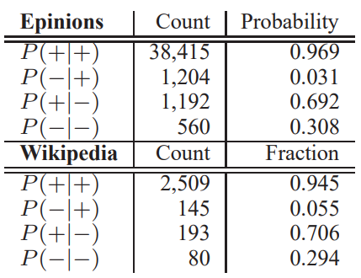
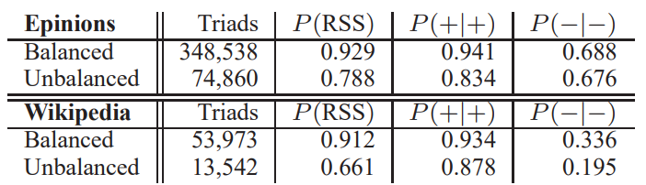
Result
Reciprocal (8%) -> structural balance
B-A link is significantly have the same sign as the A-B link
How public the edge signs are (epinions < Wikipedia)
Directed edges point both -> reinforcing mutual relationship

Slide 24
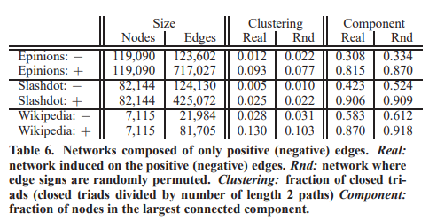
Embeddedness
Cluster (closed triad)
all-positive networks have significantly higher clustering than their randomized counterparts, and the all-negative networks have significantly lower clustering
,both the all-positive and all-negative networks are less well-connected than expected

Slide 25
Embeddedness
The giant components of real social networks are believed to consistof densely connected clusters linked by less embedded ties

Slide 26
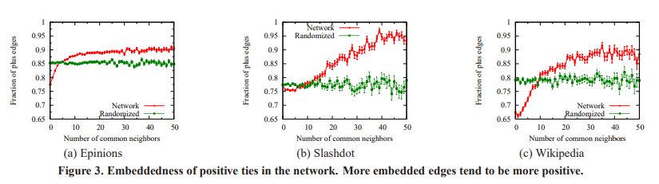
Embeddedness

Slide 27
감사합니다

